Slide 1

PAPOOSE PROPERTY SERVICES
Booking system

Slide 2
Summary
A cloud application hosted on Zoho Creator
Integrating Papoose Property Services processes – from creating a booking to invoicing
With a dedicated portal for clerks
Key features
Create & manage bookings for single or multiple services
Assign / Reassign clerks
Uploading / sending reports
Invoicing integrated with Zoho Books
Catalogue & price lists management
Clerk management
Reporting

Slide 3
Manage bookings

Slide 4
Create and Manage bookings > key features
A booking form: to add single / multiple services
Calendar: colour-coded by clerks and status (Accept/Decline)
Dashboard: Colour-coded according to required actions
Draft report: for booking in progress not yet save
Task list showing required actions for bookings coming in next 5 days
Key actions
Assign / reassign clerk to one or multiple services
Confirm one or multiple services
Cancel bookings
Edit bookings
Accessible from
Homepage
Booking form
Calendar
Dashboard

Slide 5
Create and Manage bookings > key features
Assign
Automated “new appointment” email to clerks with a link to accept / decline appointments & a booking summary.
Appointments will display in clerk portal in both their dashboard and calendar
Automated notification to Papoose Property Services up acceptation/declination appointment
Reassign clerks
Automated “new appointment” email to new clerks
Automated cancellation email to previous clerk (unless invitation was declined)

Slide 6
Create and Manage bookings > key features
Confirmation
Automated confirmation email to customers (and other contacts as per instructions in booking form)
Update booking status across the platform
Cancellation
Automated cancellation email to customers
Automated cancellation email to clerks
Possibility to add cancellation charge and automated update order / invoice
Update booking status across the platform

Slide 7
Create and Manage bookings > key features
Task board
Manage tasks such as review, upload, send reports
Create invoice and credit note
Upload reports using link with google drive
Automated email to customers sending reports
Invoicing
Update / edit order details and add promotional code
Integrated with Zoho Books
Invoice will be sent and created from Zoho Books, with automated email
Bookings will be updated with invoice number

Slide 8
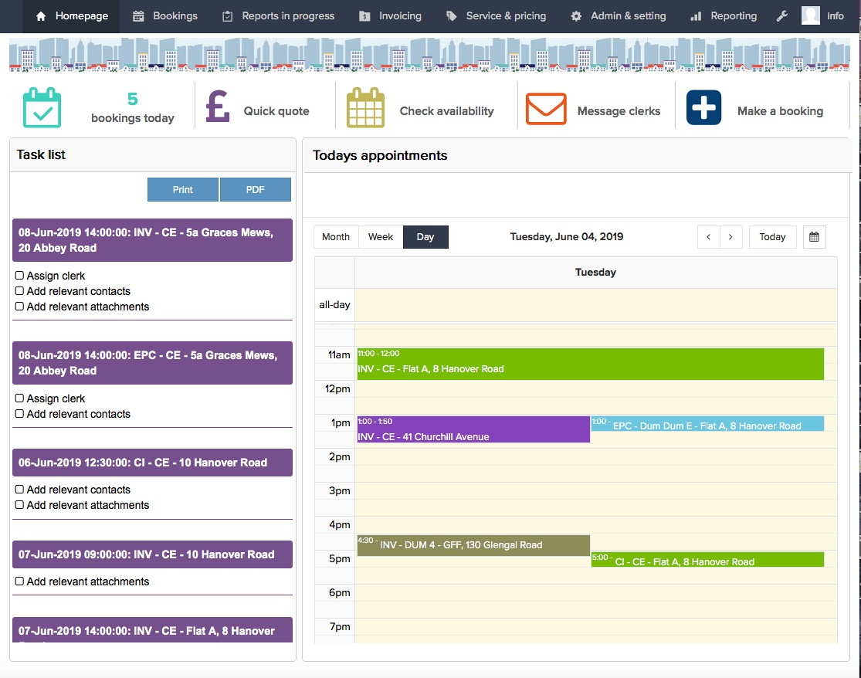
Homepage
Useful widgets and quick access to booking form
Day view of today’s appointments
Task list for bookings that needs completing in next 5 days

Slide 9
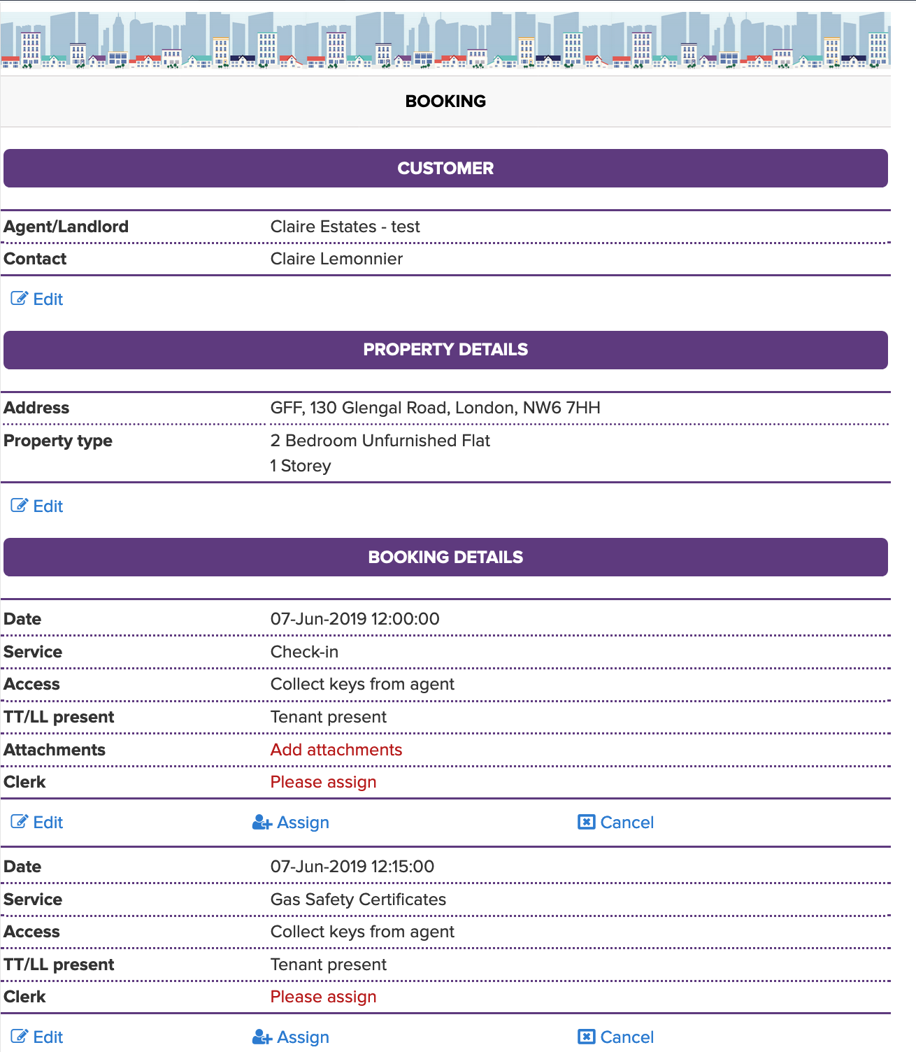
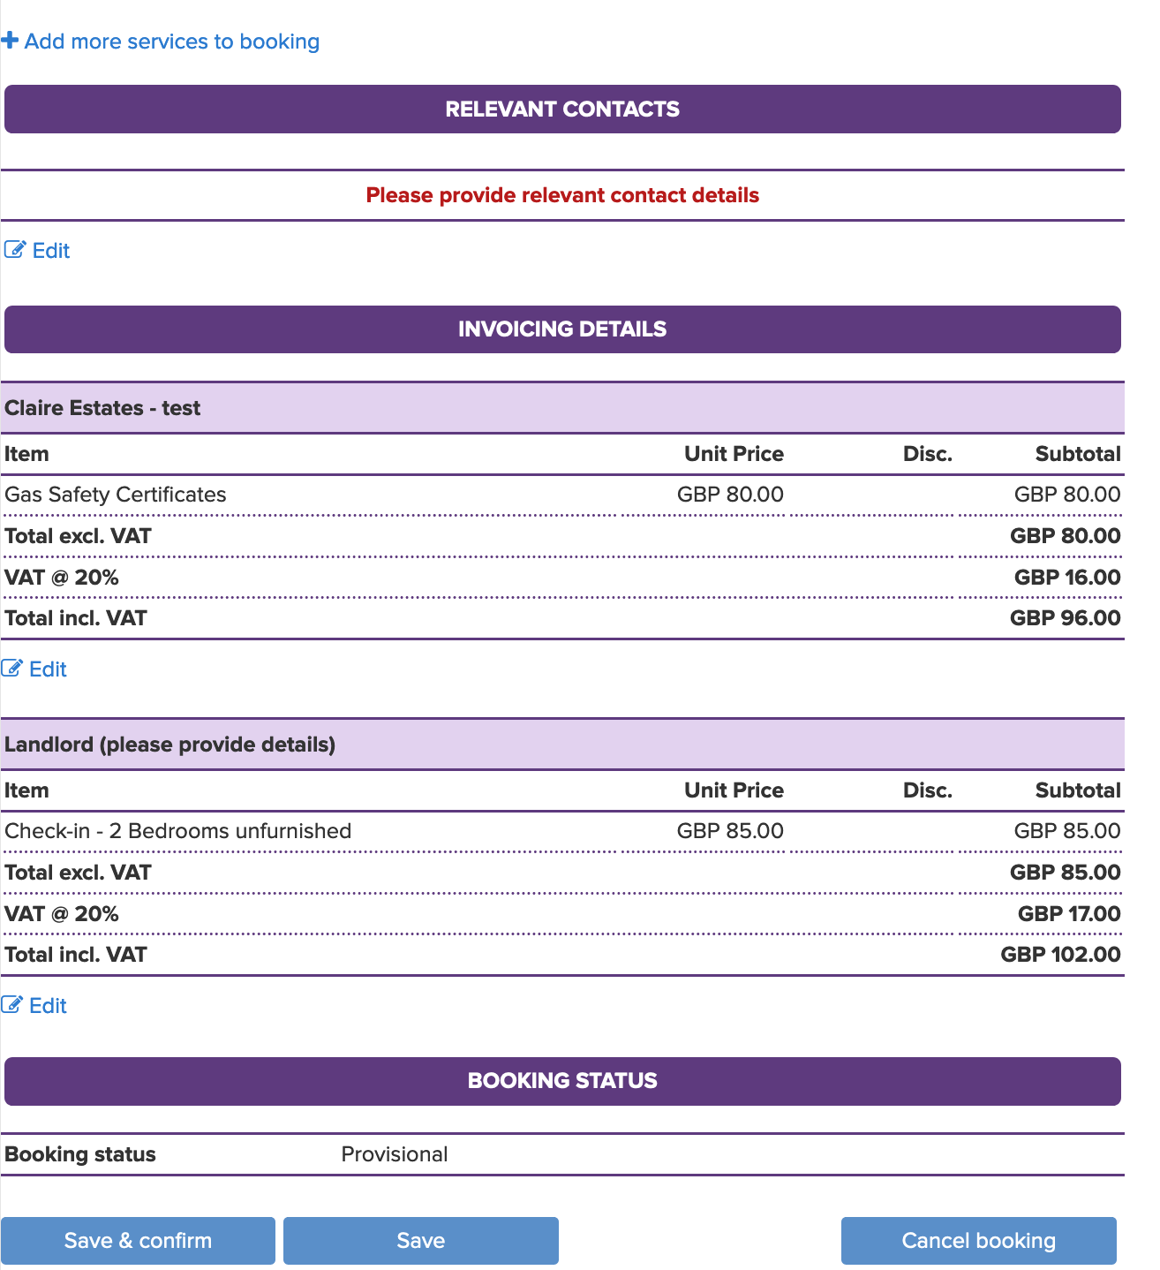
Booking form
Add one or multiple services
Invoice one or more contact
Possibility to assign/edit each services in booking

Slide 10
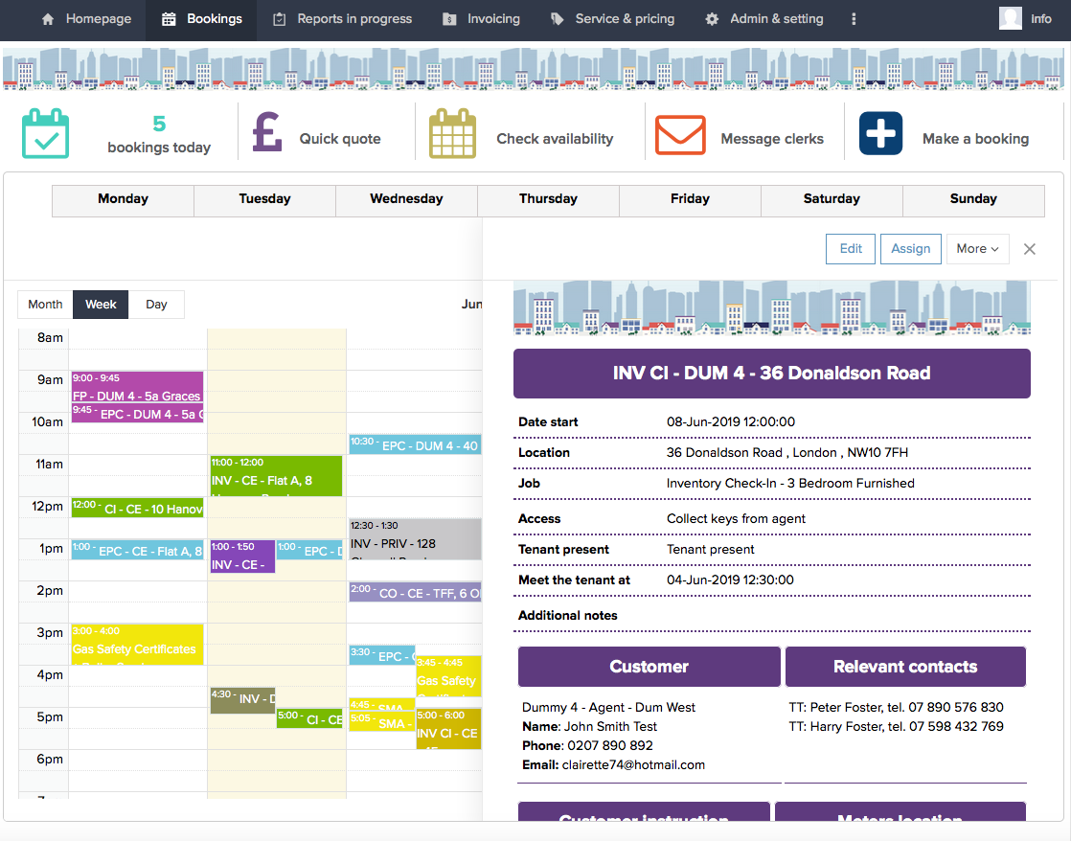
Calendar – sample view
Useful widgets
Colour-coded with clerks
Booking action
Detailed view

Slide 11
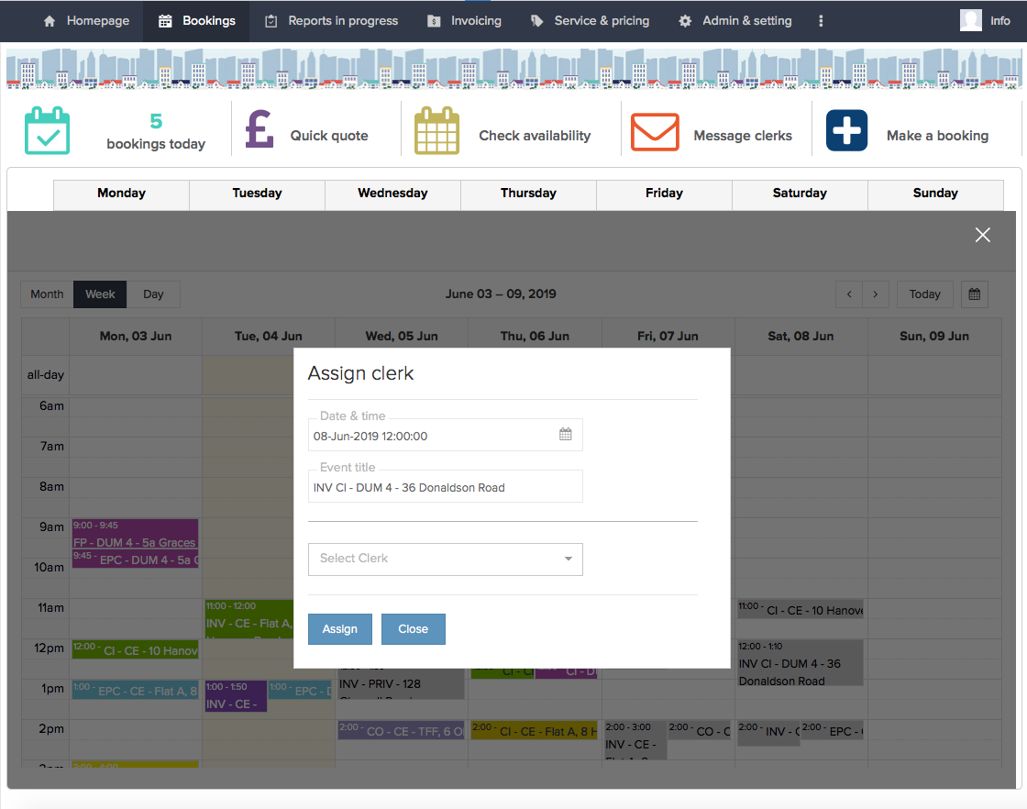
Calendar – sample view > Assign

Slide 12
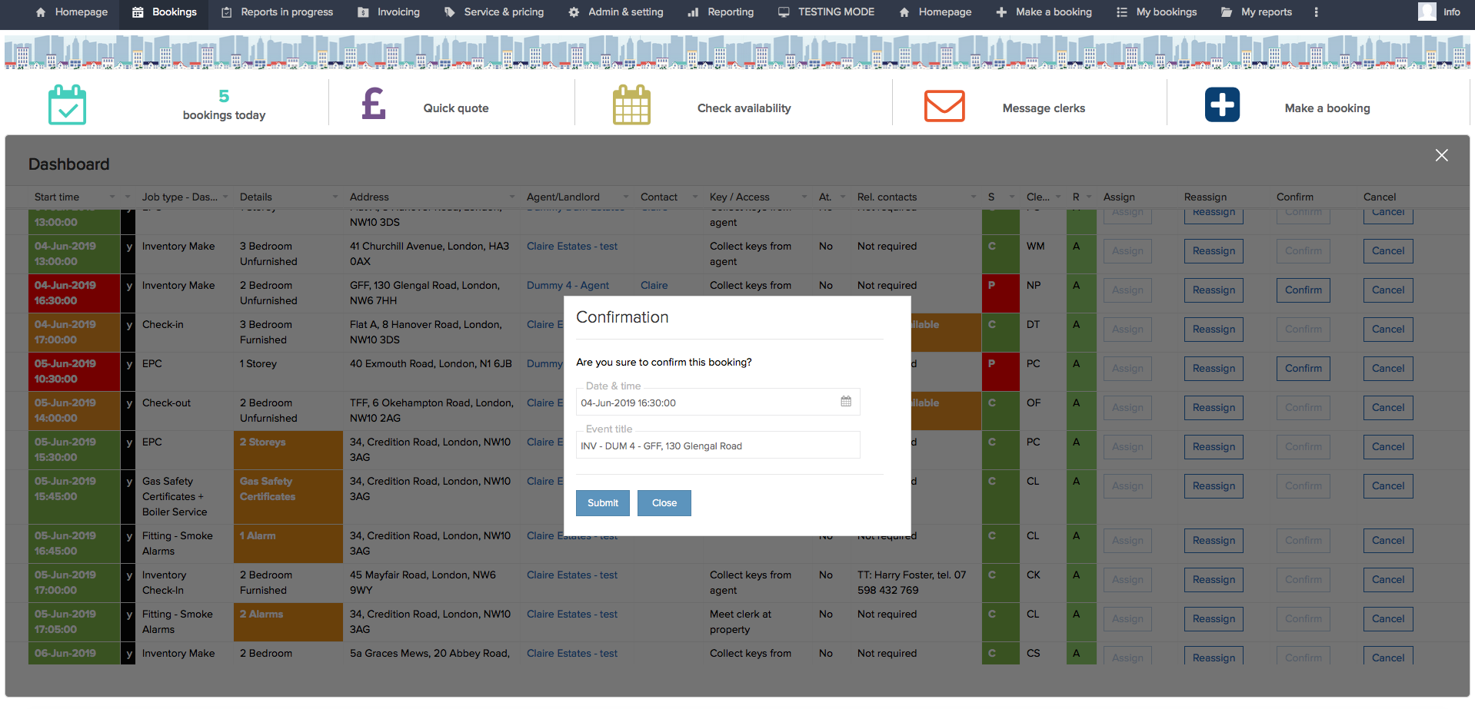
Dashboard – sample view > Confirmation
Colour-coded with status
Booking action

Slide 13
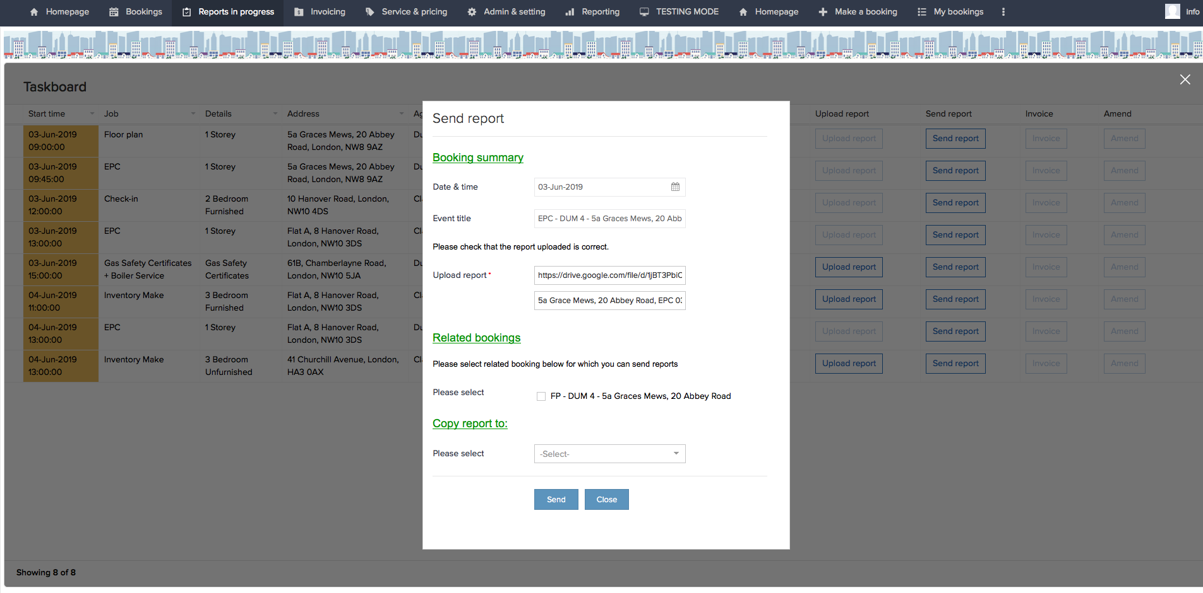
Task board – sample view > Send report

Slide 14
Clerk portal

Slide 15
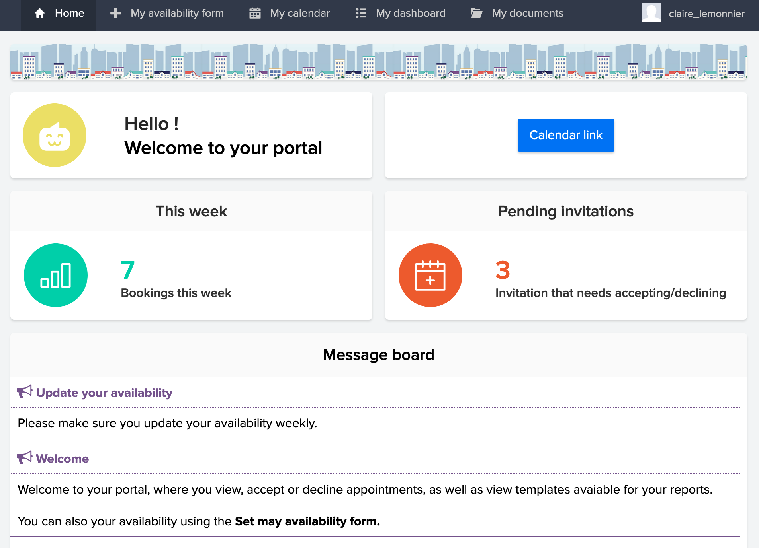
Clerk portal features
Homepage
View my calendar
View my dashboard
Set availability
View my rates
View templates

Slide 16
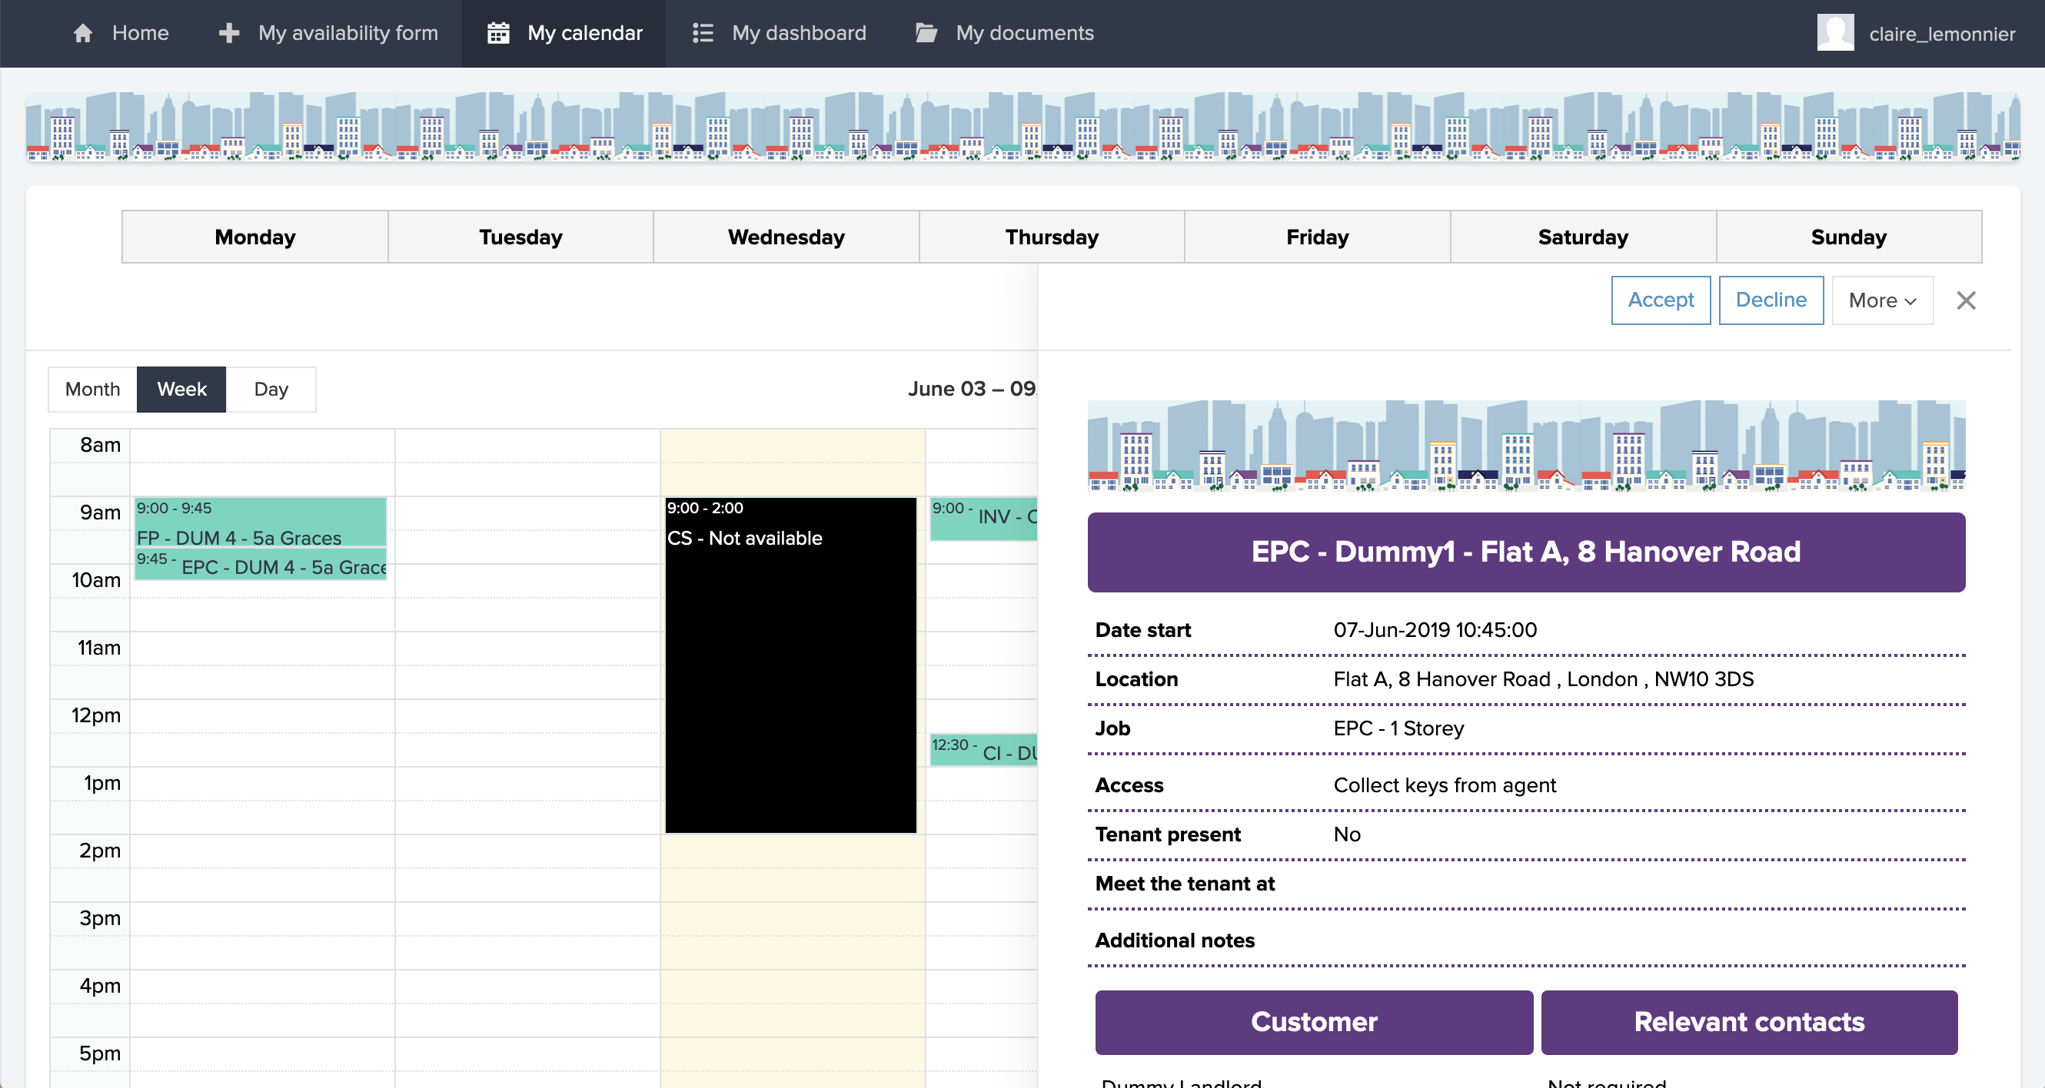
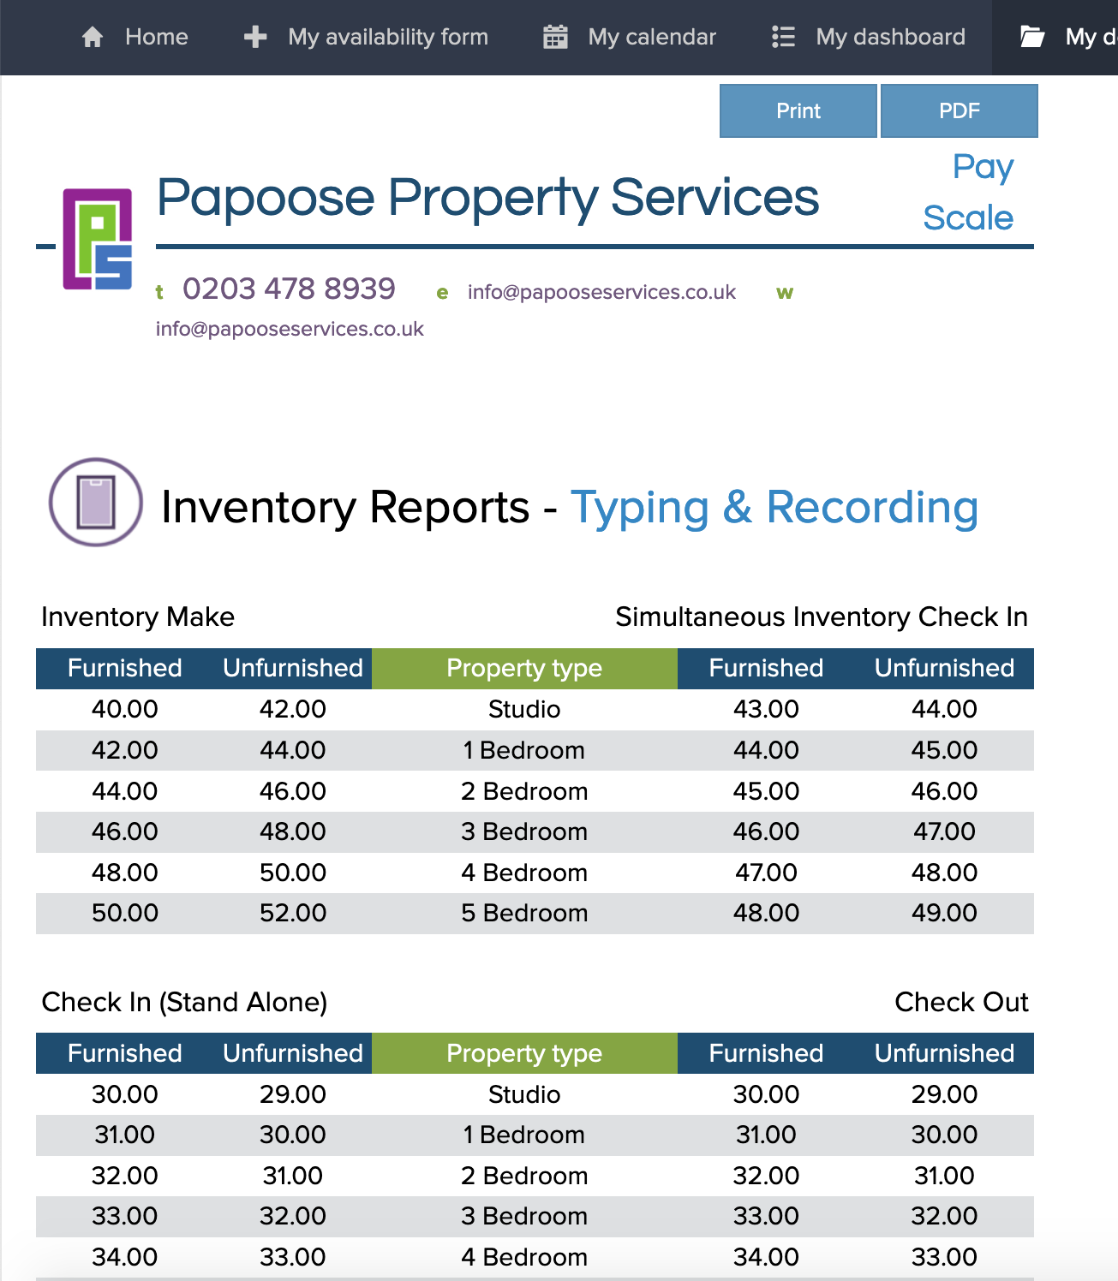
Clerk portal features
Booking action
My rates
Detailed view

Slide 17
Manage catalogue and price lists

Slide 18
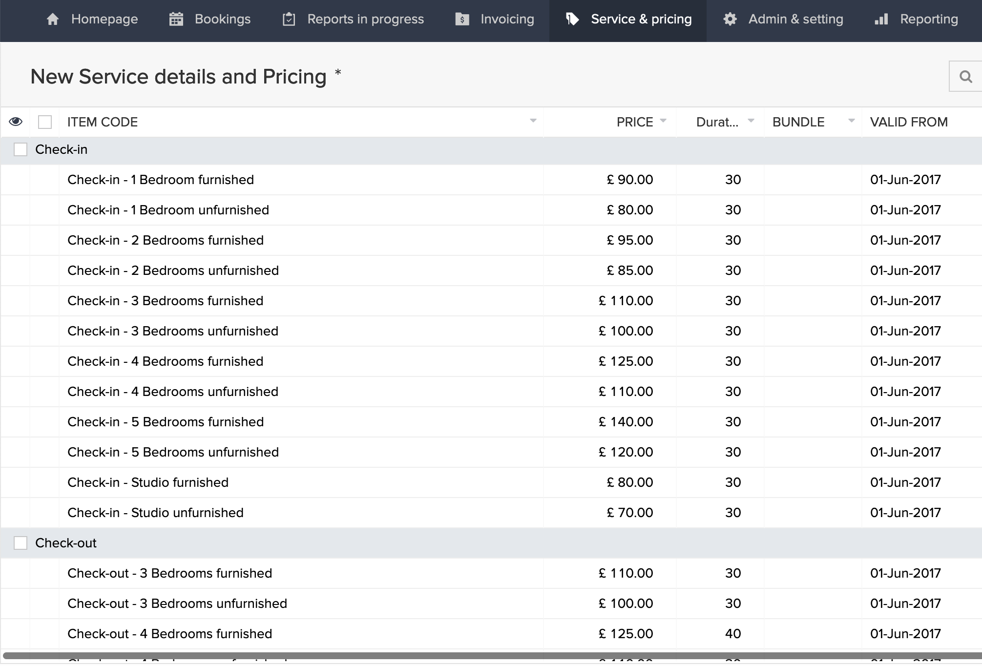
Create & Manage catalogue > key features
Catalogue
Create and edit items with price and duration according to job type parameters
Fully integrated with Zoho books
Schedule price changes

Slide 19
Create & Manage price lists > key features
Price list customer
Create and assign bespoke price list to customer based on main catalogue
Price will be reflected in bookings
Schedule for price changes
Print / download user friendly price list

Slide 20
Create & Manage price lists > key features
Price list clerk
Create and assign bespoke price list to clerks based on main catalogue
Clerk rates will be reflected in booking for costing and audit purpose
Schedule for price changes
Print / download user friendly price list
Accessible from the portal

Slide 21
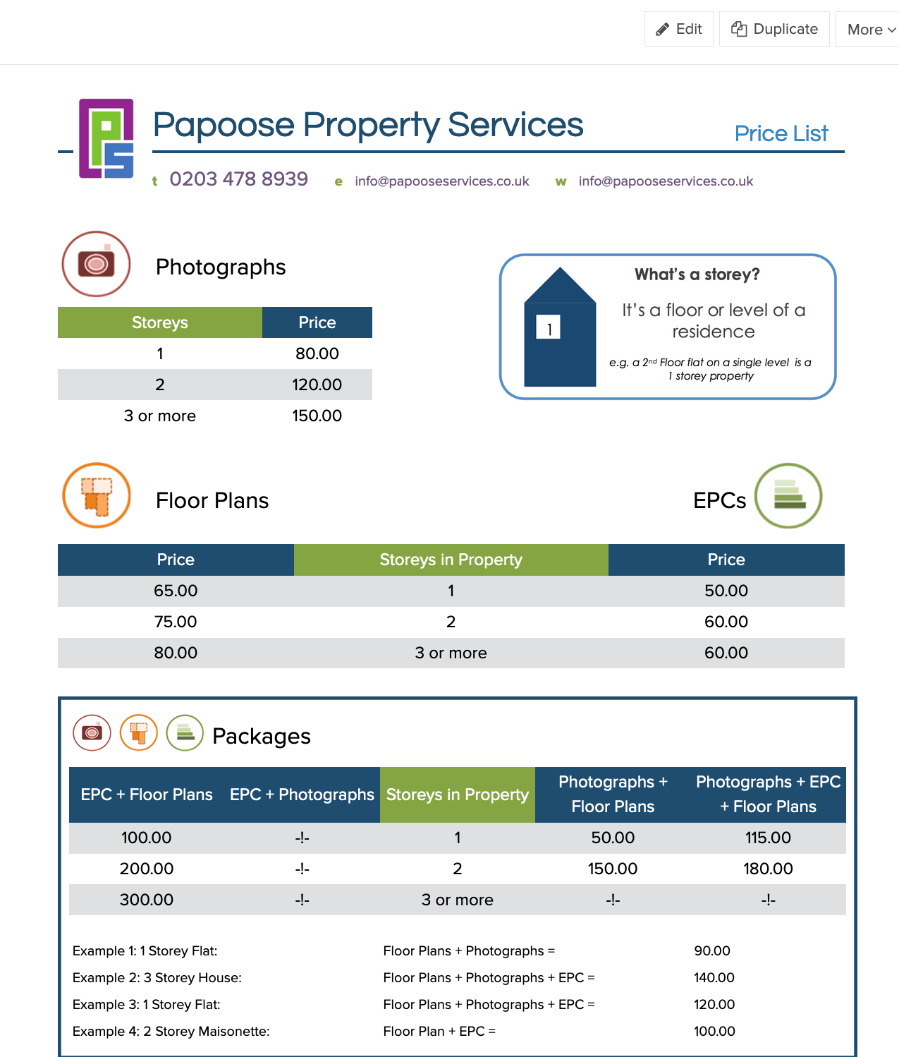
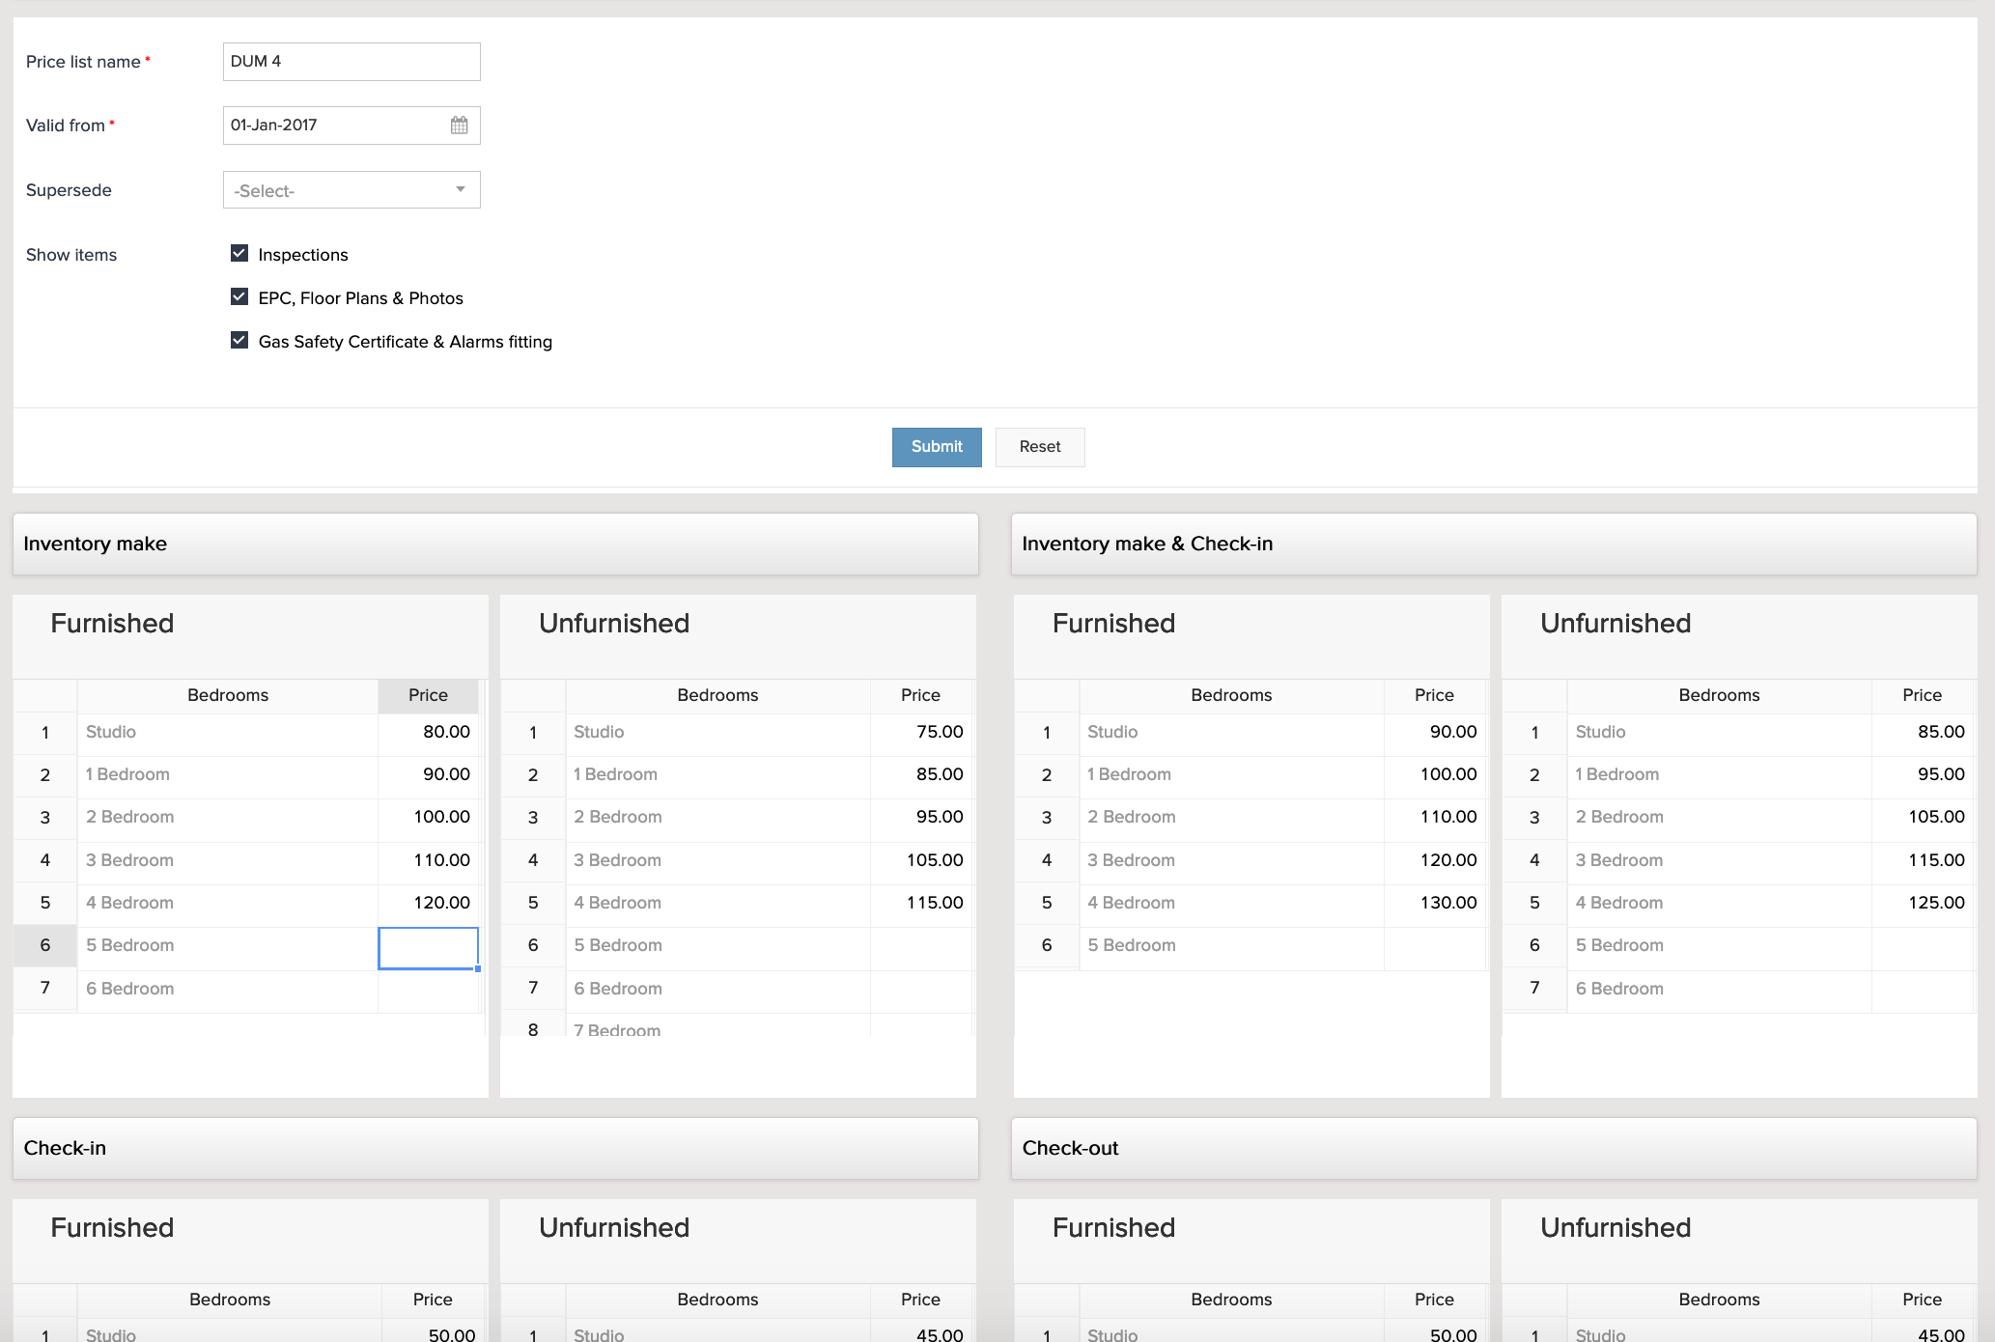
Create & Manage price lists
Print/pdf price lists
Set price list

Slide 22
Parameters

Slide 23
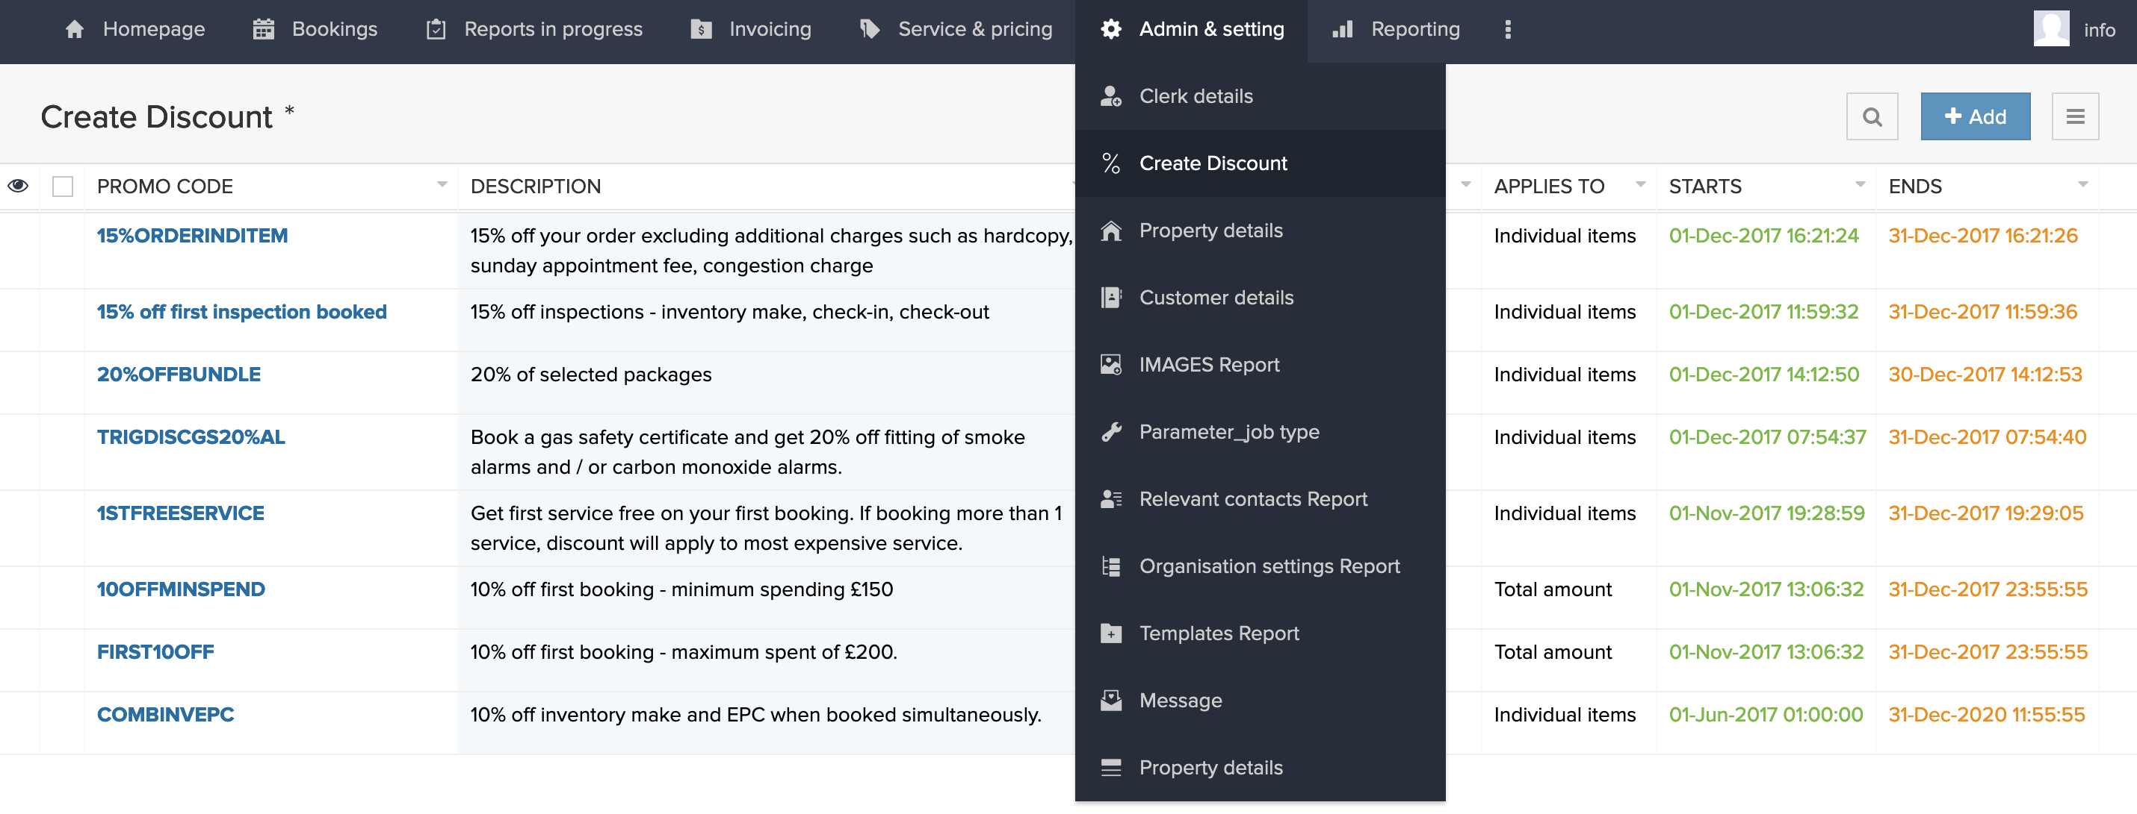
Parameters > key features
Add/edit/delete items for each type of parameters
Presented in list reports

Slide 24
Parameters > key features
Clerk details
To add/edit/ delete clerks
Set clerks parameter such as jobs they can be assigned to
Assign price list clerk
Assign portal users
Customer details
To add/edit/delete customers
Integrated with Zoho Books
Set parameters such as default invoice & reports templates
Include customer instructions
Include contact details for customer branch, also integrated with zoho books

Slide 25
Parameters > key features
Property details
Add/edit/ delete properties
Set property parameters (to be reflected in bookings) such as property size, furnishing, storeys …
Additional information on gas & electricity meters
Relevant contact details
Details for tenants and landlords linked to bookings and properties
Template reports
Add/edit/delete templates for inspection reports
Accessible from the clerk portal

Slide 26
Parameters > key features
Create discount
Add/edit/ delete promotional code
Set promotion according to period of times and selected products
Can be applied in % or GBP to the order details
Parameter job type
Add/edit main job categories
Set price list type such as property size, surface or flat fee – to define the configuration of products in the catalogue
Can be set as active/inactive on different platform such as website / portal
Can be set as backend for add-ons

Slide 27
Parameters > key features
Organisation settings
Add/edit invoicing parameters as set on Zoho Books with invoice templates, payment terms …
Relevant contact details
Add/edit images use across the application
Messages
Add/edit/delete message to be shown on portal
Automated email to clerks according to validity and frequency

Slide 28
Reporting

Slide 29
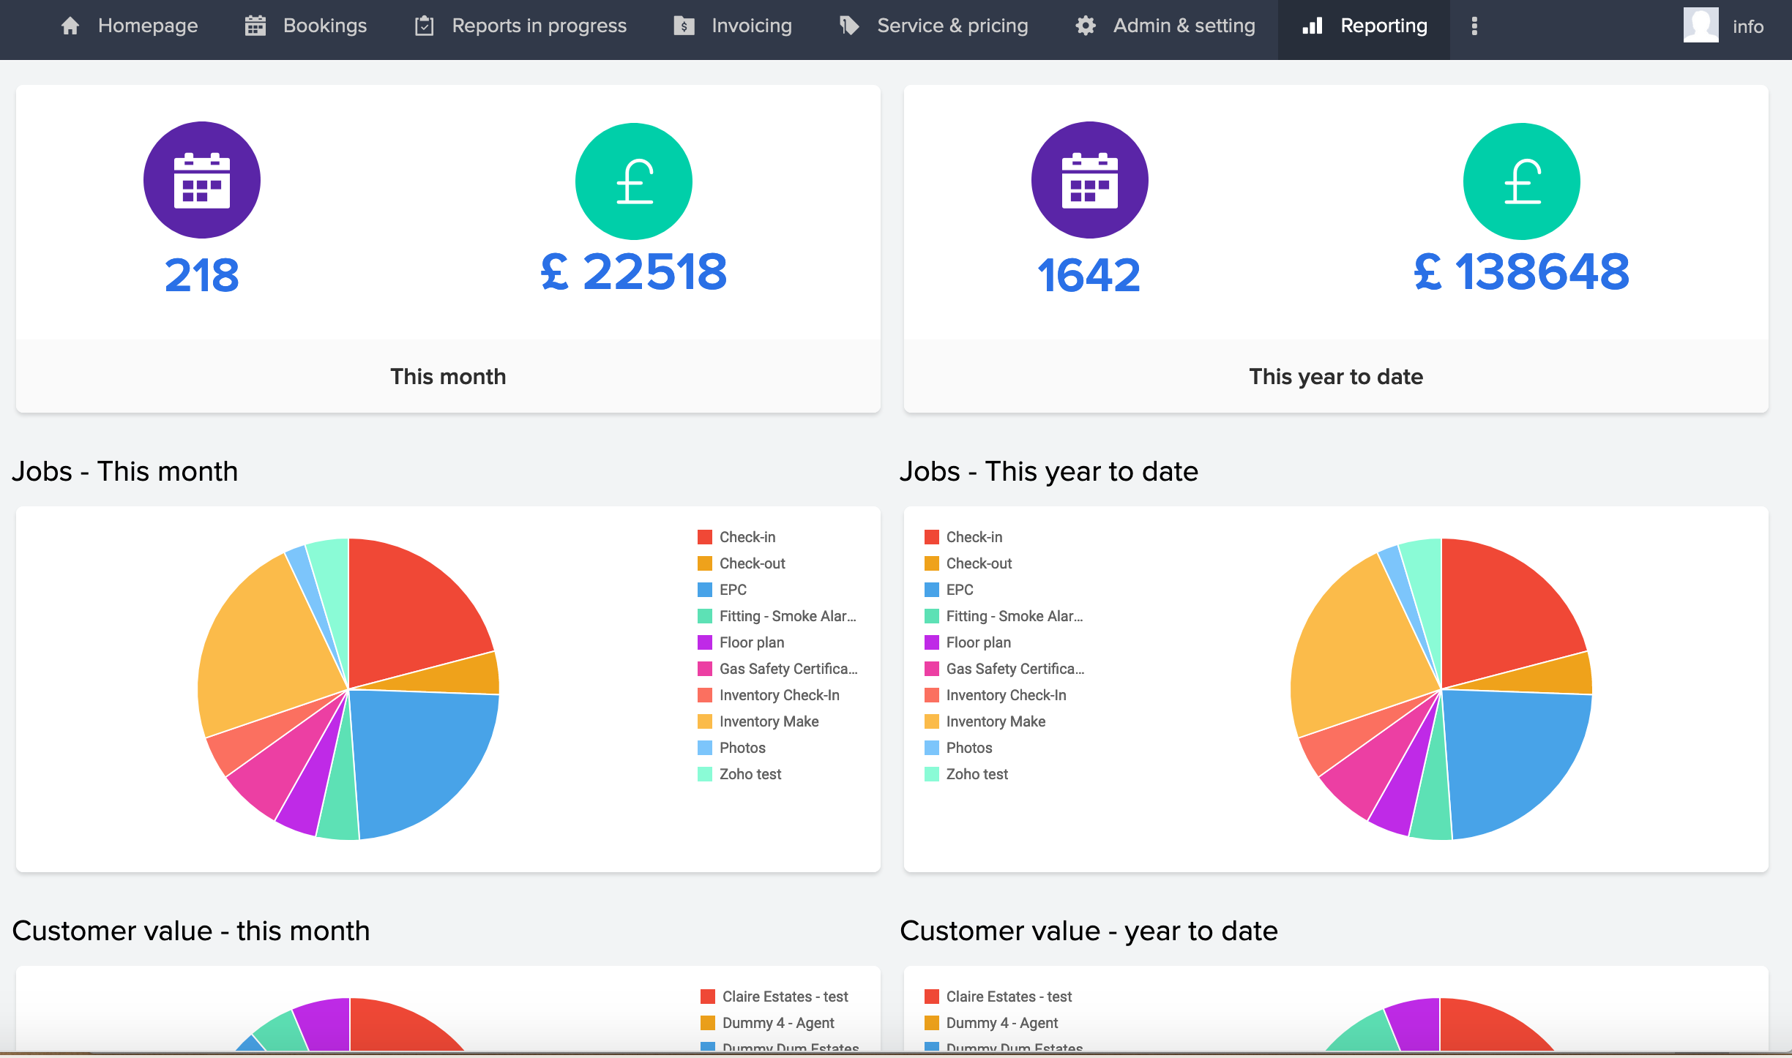
Reporting
Visualization of the activity
List of all the bookings

Slide 30
Thank you

